Slide 1
SECURE DATA ENCRYPTION
USING CRYPTOGRAPHY

Slide 2
GROUP DETAILS
Department : Computer Science & Engineering
Semester : VII
KOMOLIKA AGARWAL (18ETCCS053)
PIHU JAIN (18ETCCS071)
ISHIKA JAIN (18ETCCS046)

Slide 3
ACKNOWLEDGEMENT
We are very grateful to our teachers and professors who give us a chance to work on this project. We would like to thank him for giving us valuable suggestions and ideas.
We would like to thank our college for providing us all the necessary resources for the project .

Slide 4
ABOUT PROJECT
Digital communication witnesses a noticeable and continuous development in many applications in the Internet. Hence, secure communication sessions must be provided. The security of data transmitted across a global network has turned into a key factor on the network performance measures. So, the confidentiality and the integrity of data are needed to prevent eavesdroppers from accessing and using transmitted data.
So ,We are creating a windows application that is used for converting the plaintext into ciphertext . Application uses the powerful techniques of cryptography.

Slide 5
CRYPTOGRAPHY
Cryptography is a method of protecting information and communication through the use of code , so that only those for whom the information is intended can read and process it.
It secures information & communication from algorithms that are derived from mathematical concepts and set of rule based calculations to transform messages in ways that are harder to decipher. These algorithms are used for cryptographic key generation , confidential communication such as credit card transaction & emails , web browsing on internet , etc.

Slide 6
TYPES OF CRYPTOGRAPHY
SINGEL KEY OR SYMMETRIC KEY ENCRYPTION
PUBLIC KEY OR ASYMMETRIC KEY ENCRYPTION

Slide 7
SINGEL KEY OR SYMMETRIC KEY ENCRYPTION
It creates a fixed length of bits known as a block cipher with a secret key that the creator/sender uses to encipher data (encryption) and the receiver uses to decipher it. Examples of this type :
Advanced Encryption Standard (AES) it is successor to the DES and DES3 . It uses longer key length 128 bits, 192 bits , 256 bits to prevent brute force and other attacks. It is established in November 2001 by the National Institute of Standards and Technology(NIST) as a Federal Information Processing Standard(FIPS 197) to protect sensitive information.

Slide 8
PUBLIC KEY OR ASYMMETRIC KEY ENCRYPTION
It uses a pair of keys, a public key associated with the creator/sender for encrypting messages and a private key that only the originator knows (unless it is exposed or they decide to share it) for decrypting that information. Example of this type :
RSA used widely on the internet. The RSA algorithm is named after those who invented it in 1978: Ron Rivest, Adi Shamir, and Leonard Adleman.The RSA algorithm ensures that the keys, are as secure as much possible as can . For this it takes two large prime numbers x and y and multiply them. The two integers are co-prime if the only positive integer that divides them is 1.

Slide 9
OBJECTIVE OF PROJECT
The purpose of this project is to provide the correct data with security to the users.
Only the Authorized persons i.e., who are using our application will be there in the Network who can access the data and decrypt the data for their use.
In Asymmetric algorithm an encryption technique is employed for encrypting a secret message into a Cipher text using the Senders Private Key and receiver public key. The Cipher Text is finally embedded in a suitable cover image and transferred securely to deliver the secret information.

Slide 10
METHODOLOGY OF PROJECT
First the user will register or login on the application.
On start, the user will be required to choose the method i.e. encryption or decryption
If the user chooses the method encryption then further the encryption technique option will be given to import the private key and then further select file or folder foe AES Encryption..
If user selects On submit the uploaded file will be encrypted with key and the encryption key will be stored in the database.

Slide 11
METHODOLOGY OF PROJECT
The encrypted data will be stored in new file created by user and will be saved in user defined location
If the user chooses decryption the user will be required to provide the key details of the encrypted file.
Basis of the details the decryption will be performed.
The decrypted data will be stored in new file created and will be saved in user defined location.

Slide 12
APPLICATION
It is used for decrypting the logs that are created by various application at runtime .
It is used to transfer various confidential application data to clients.

Slide 13
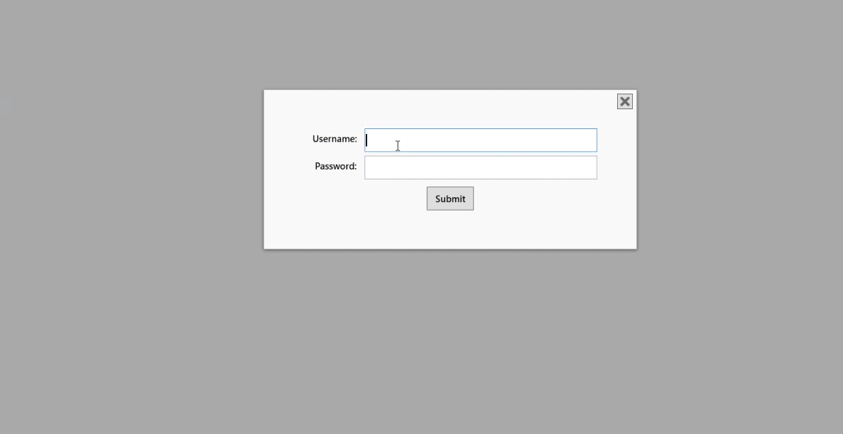

Slide 14
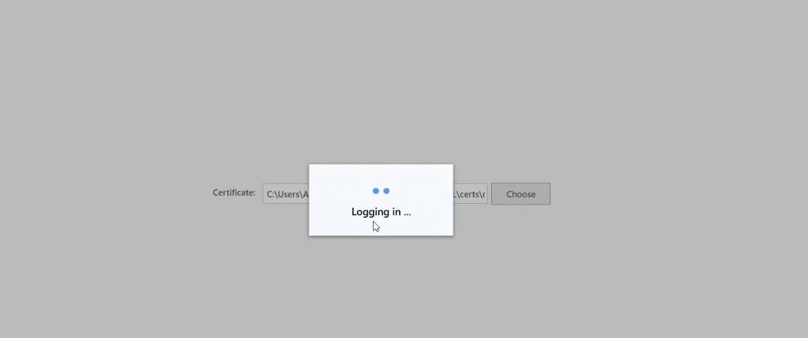

Slide 15
Encryption Flow

Slide 16
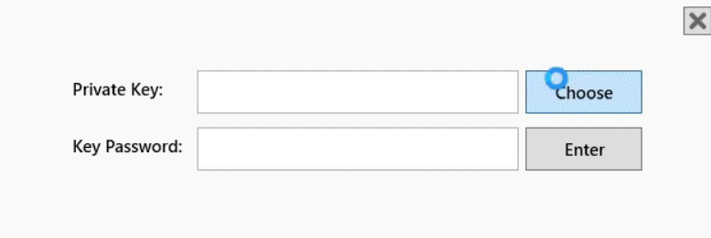

Slide 17
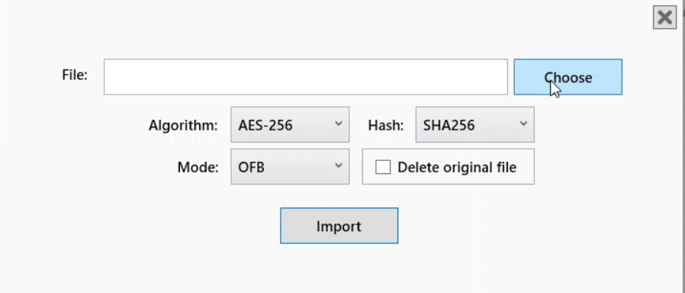

Slide 18
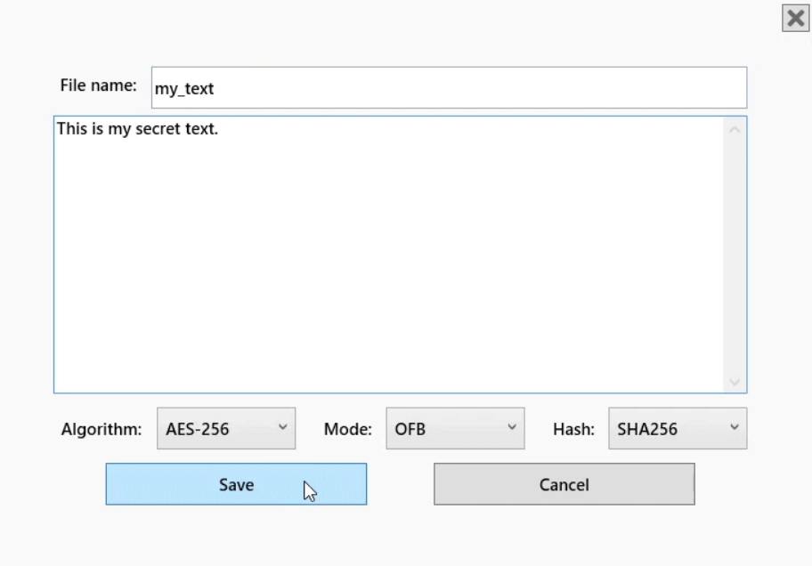

Slide 19
Decryption Flow

Slide 20
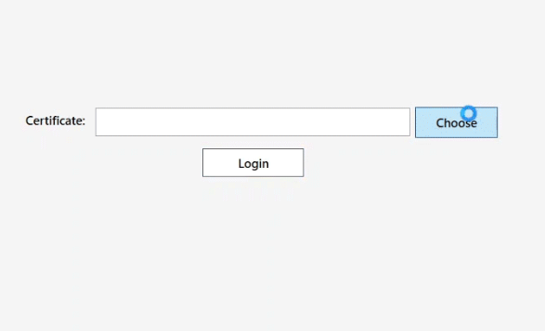
First the user will need to select the certificate for the authentication

Slide 21
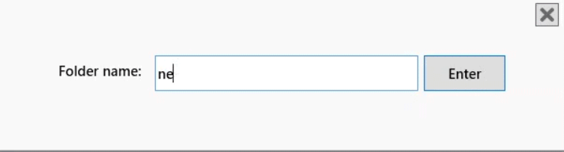

Slide 22
PROJECT DEPENDENCIES
C#
.NET
Microsoft Visual Studio
SQL Server

Slide 23
PROJECT CONCLUSION
In this project, we deal with the concepts of security of digital data communication across the network.
By the development of the windows application we got a clear understanding of the various cryptographic techniques used by our network security department.
We also learned Team Work and Team Management to take our project at an level to succeed.

Slide 24
THANK YOU

